Slide 1

Farming is a profession of hope

Slide 2

NGO - INDIAN SOCIETY OF AGRIBUSINESS PROFESSIONALS
TEAM 5

Slide 3
TEAM MEMBERS
GAGAN SHETTY
KEERTHIKA A
NIKEETHA M S
PUNYA SHETTY
SHAILY SINHA

Slide 4
Introduction
Indian Society of Agribusiness Professionals since 2001 is working for the empowerment of rural India through sustainable farm and non-farm livelihood development.
The mission of the project is to enhance livelihood opportunities and thereby result in better quality of life for rural communities through sustainable intensification of Agriculture, Skill Development and Market Integration.

Slide 5
PROBLEM STATEMENT
ISAP needs an automated and efficient system to manage their supply-chain and resource management to streamline the co-ordination with CHSCs.
Looking for a web based and mobile application which will help the farmers and heads to leverage technology.

Slide 6
Modules DEVELOPED
Farmer: Farmer uses the application for booking the equipments
Centre Head: This module will be used by the Centre Head for approving farmer’s request and to manage the machinery inventory
State monitor: This module helps the State monitor to analyze the centre wise report and track machines
Project Monitors: This module helps the Project monitor to analyze the state wise reports

Slide 7
TECHNICAL SPECIFICATIONS
Backend tool
Firebase
Frontend tools
Angular 6
HTML,CSS
Python

Slide 8
Flow Chart

Slide 9
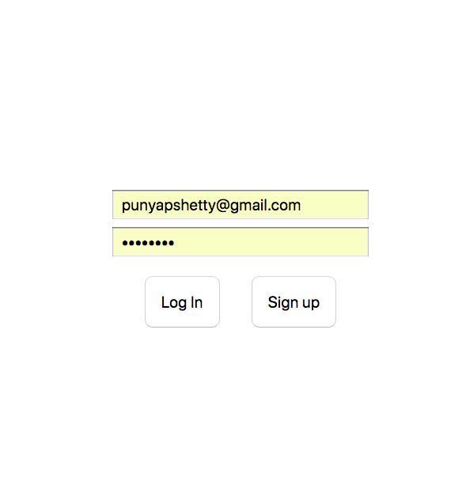
SNAPSHOTS(Mobile app)
Log in Screen

Slide 10
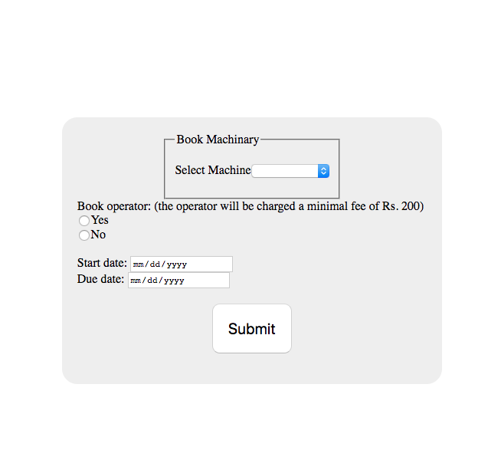
Booking screen

Slide 11
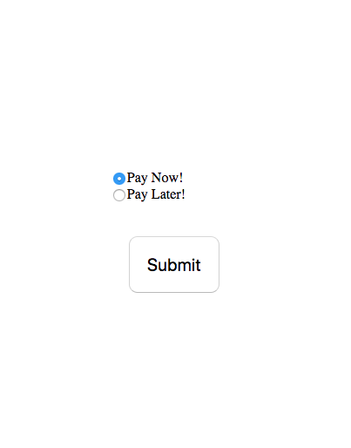
Payment Screen

Slide 12
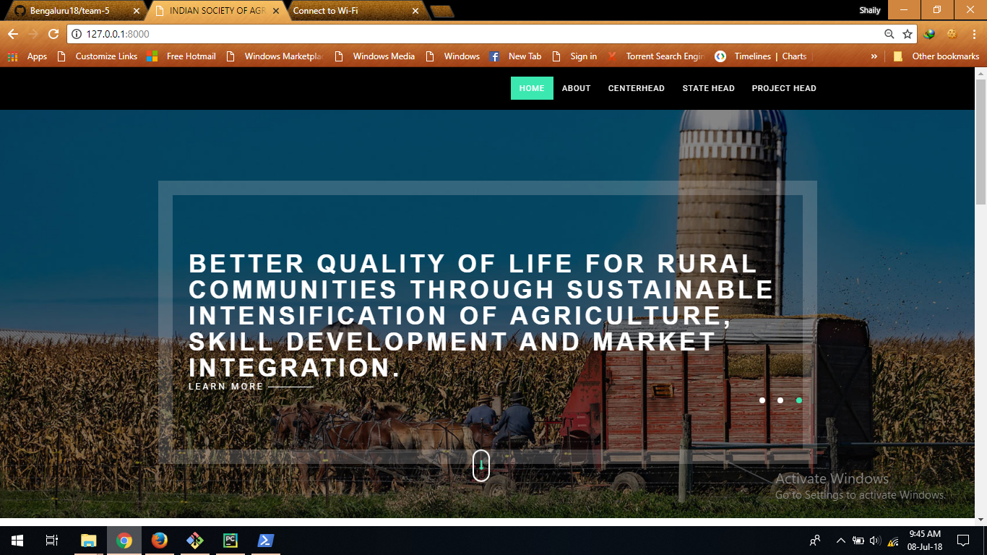
SNAPSHOTS(WEB APP)

Slide 13
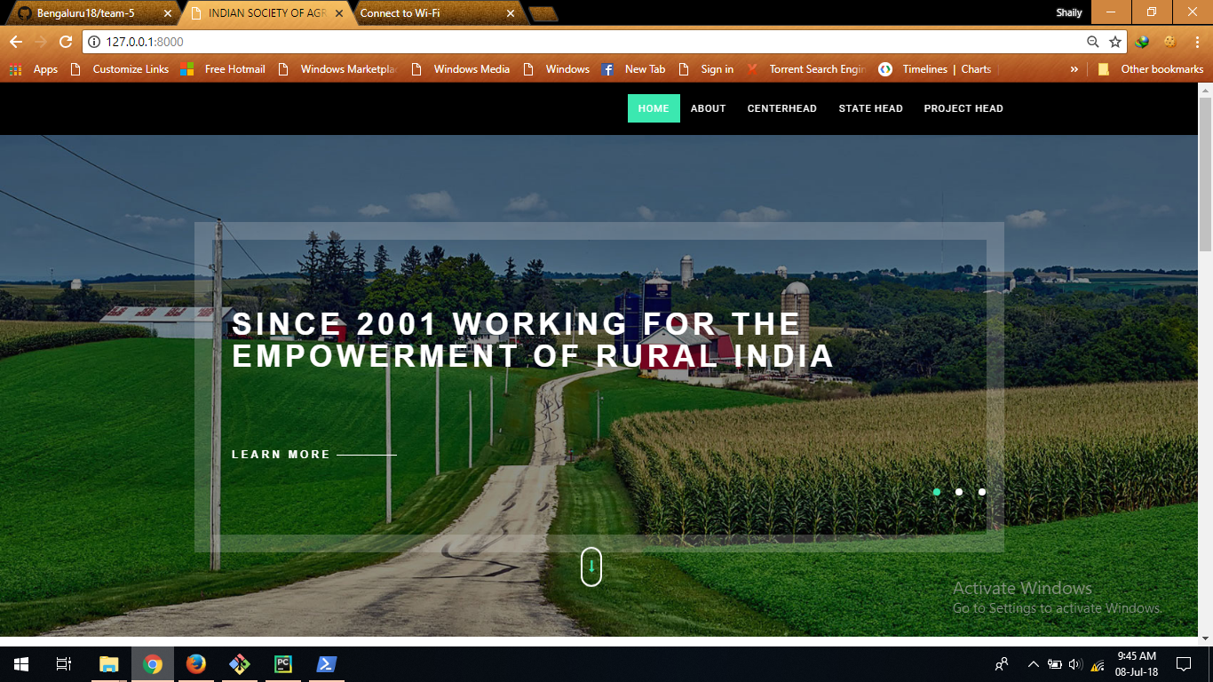

Slide 14
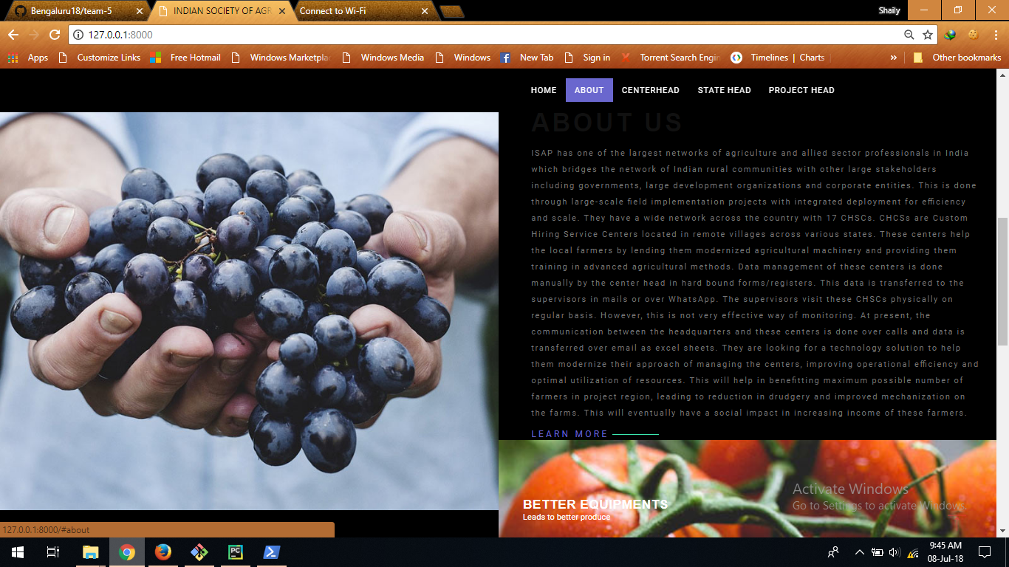

Slide 15
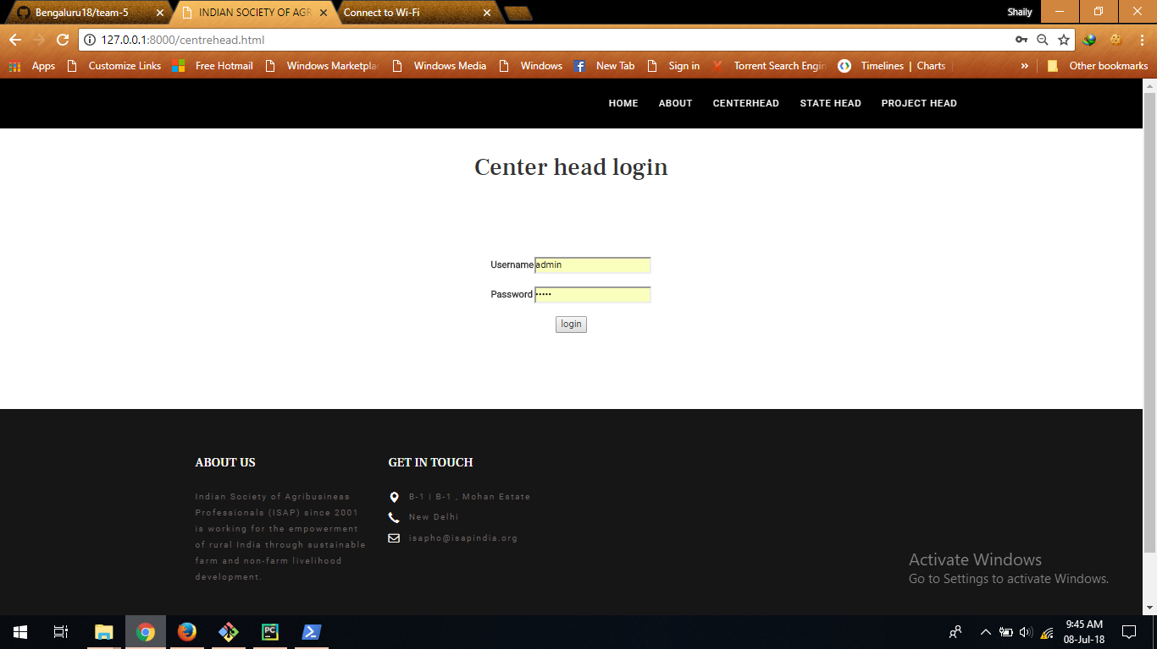

Slide 16
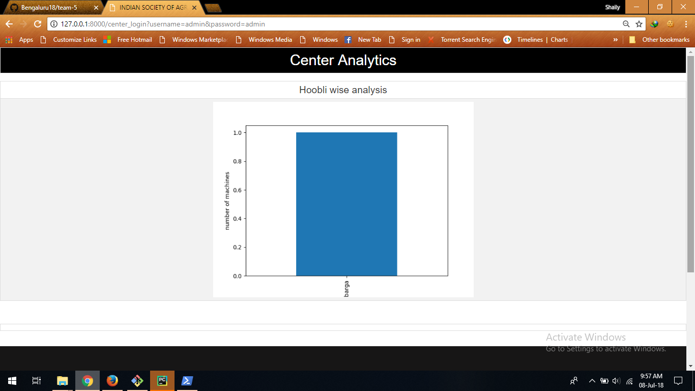

Slide 17
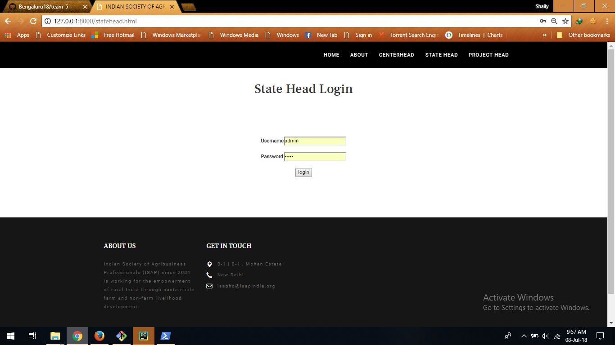

Slide 18
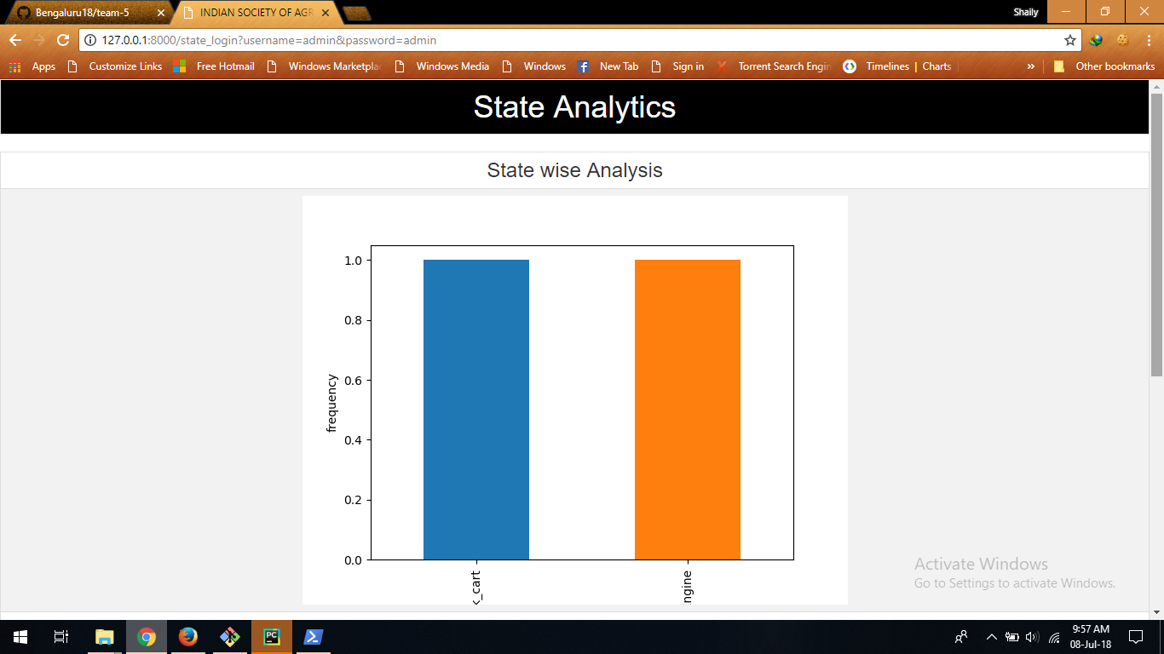

Slide 19
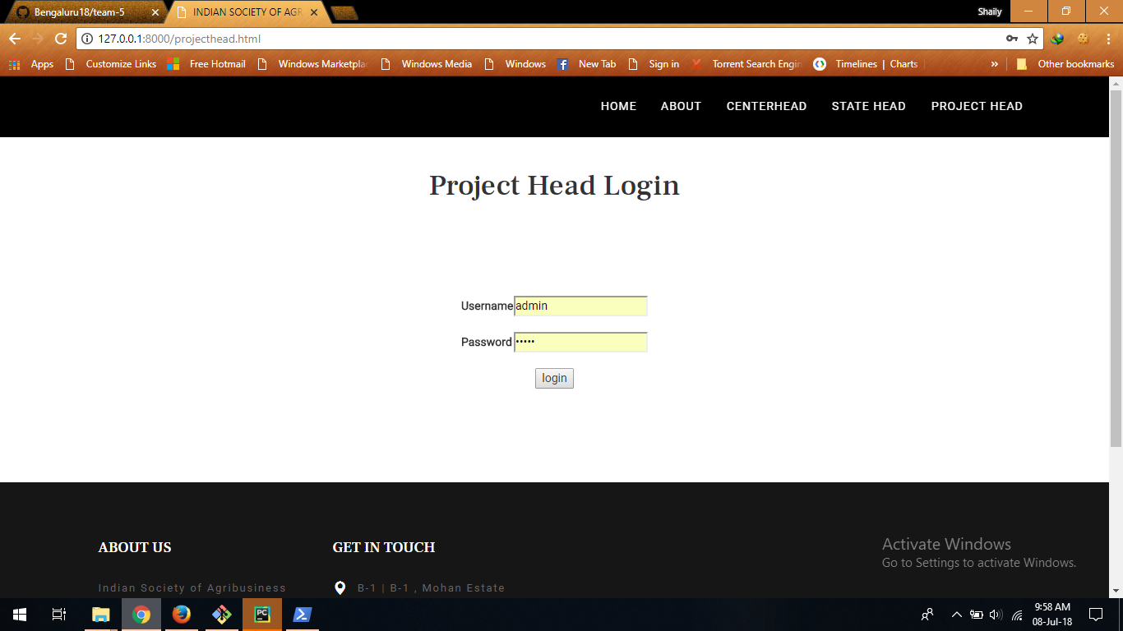

Slide 20
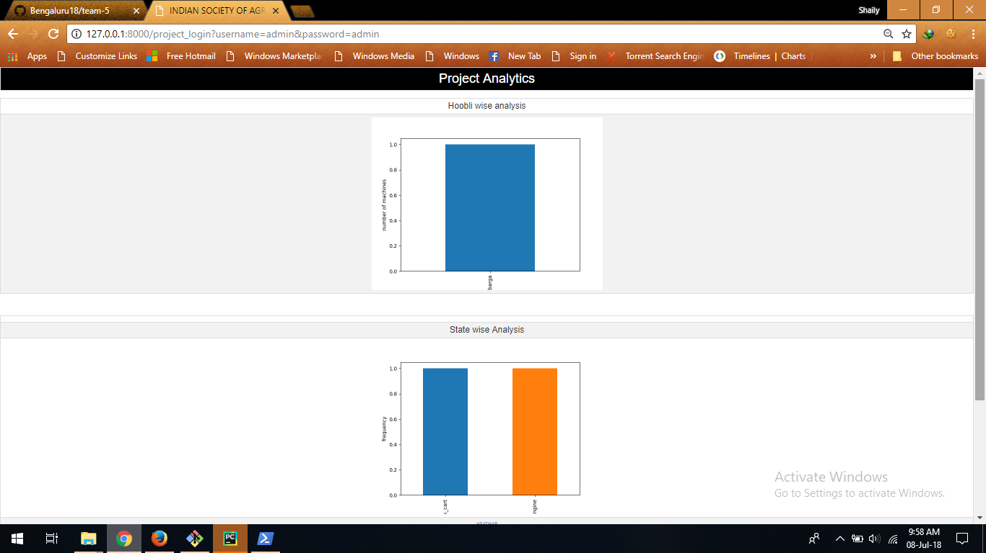

Slide 21
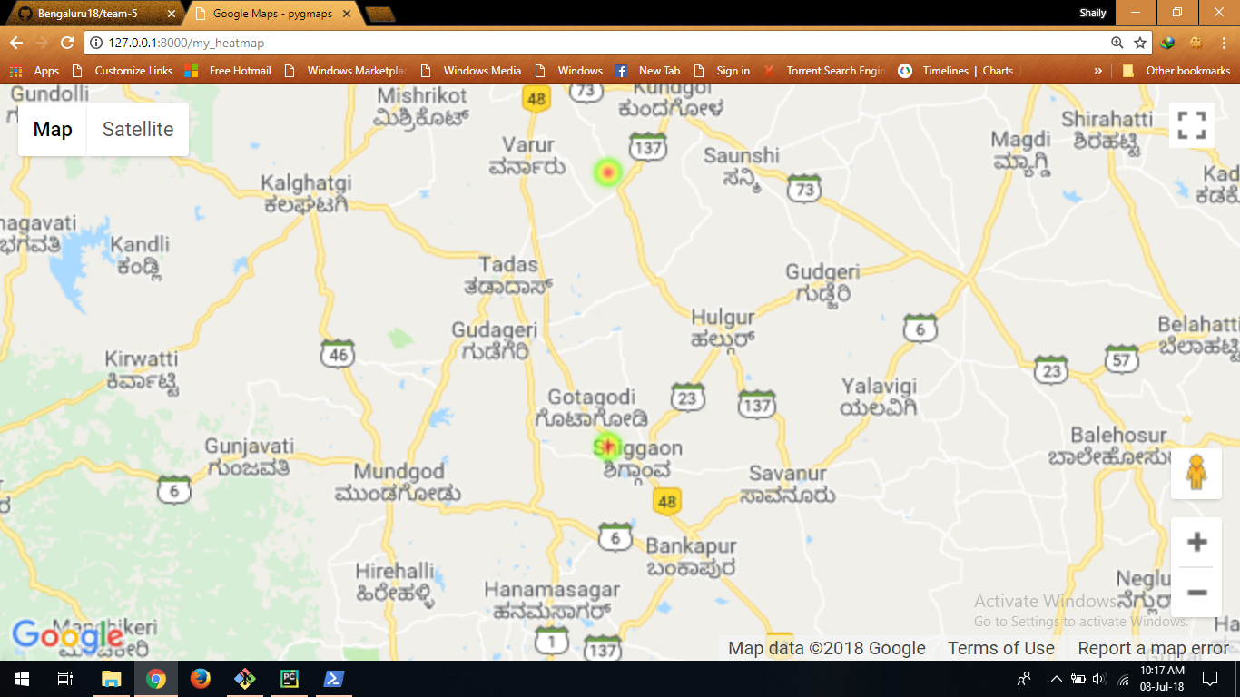
HEAT MAP

Slide 22
Future Scope
Following features can be added to this existing
application which will improve user experience:
Feedback from farmer.
Modes of payment.
Feedback notification to the centre head.

Slide 23
THANK YOU

